Slide 1
Models and Architectures
Matt Evett
Dept. Computer Science
Eastern Michigan Univ.
Angel and Shreiner: Interactive Computer Graphics 7E © Addison-Wesley 2015, mods M. Evett

Slide 2
Objectives
Learn the basic design of a graphics system
Introduce pipeline architecture
Examine software components for an interactive graphics system
Angel and Shreiner: Interactive Computer Graphics 7E © Addison-Wesley 2015, mods M. Evett

Slide 3
Image Formation Revisited
Can we mimic the synthetic camera model to design graphics hardware software?
Application Programmer Interface (API)
  Need only specify
    Objects
    Materials
    Viewer
    Lights
But how is the API implemented?
Angel and Shreiner: Interactive Computer Graphics 7E © Addison-Wesley 2015, mods M. Evett

Slide 4
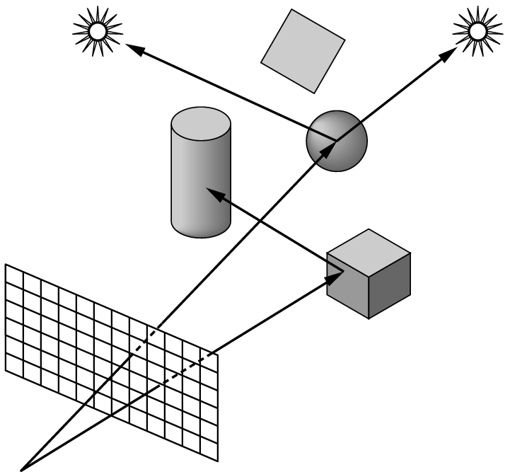
Physical Approaches
Ray tracing: follow rays of light from center of projection until they either are absorbed by objects or go off to infinity
  Can handle global effects
    Multiple reflections
    Translucent objects
  Slow (but becoming tenable….)
  Must have whole data base
  available at all times
Radiosity: Energy based approach
  Very slow
Angel and Shreiner: Interactive Computer Graphics 7E © Addison-Wesley 2015, mods M. Evett
Notes:
“whole DB” in that we can’t develop image of one object with access to all

Slide 5
Practical Approach
Process objects one at a time in the order they are generated by the application
  Can consider only local lighting
Pipeline architecture
All steps can be implemented in hardware on the graphics card
application
program
display
Angel and Shreiner: Interactive Computer Graphics 7E © Addison-Wesley 2015, mods M. Evett

Slide 6
Vertex Processing
Much of the work in the pipeline is in converting object representations from one coordinate system to another
  Object coordinates
  Camera (eye) coordinates
  Screen coordinates
Every change of coordinates is equivalent to a matrix transformation
Vertex processor also computes vertex colors
Angel and Shreiner: Interactive Computer Graphics 7E © Addison-Wesley 2015, mods M. Evett

Slide 7
Projection
Projection is the process that combines the 3D viewer with the 3D objects to produce the 2D image
  Perspective projections: all projectors meet at the center of projection
  Parallel projection: projectors are parallel, center of projection is replaced by a direction of projection
Angel and Shreiner: Interactive Computer Graphics 7E © Addison-Wesley 2015, mods M. Evett

Slide 8
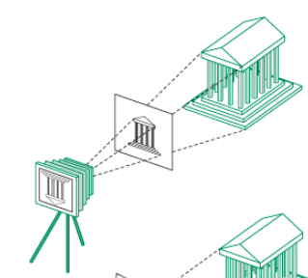
Perspective Projection
Projectors converge
Angel and Shreiner: Interactive Computer Graphics 7E © Addison-Wesley 2015, mods M. Evett

Slide 9
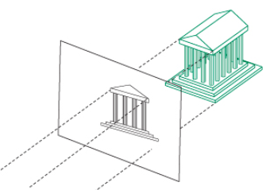
Orthographic Projection
Projectors are parallel (and usually perpendicular to plane of projection)
Similar to moving perspective camera infinitely far away (and zooming in!)
Angel and Shreiner: Interactive Computer Graphics 7E © Addison-Wesley 2015, mods M. Evett

Slide 10
Primitive Assembly
Vertices must be collected into geometric objects before clipping and rasterization can take place
  Line segments
  Polygons
  Curves and surfaces
Angel and Shreiner: Interactive Computer Graphics 7E © Addison-Wesley 2015, mods M. Evett
Notes:
I.e., we can’t calculate angles of incidence, etc., unless we know the plane of each polygon, etc.

Slide 11
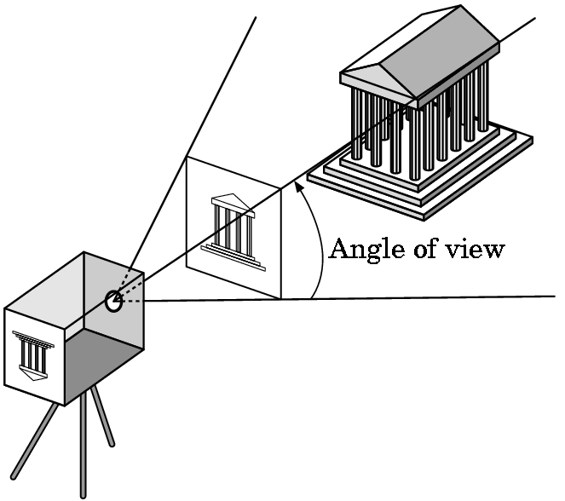
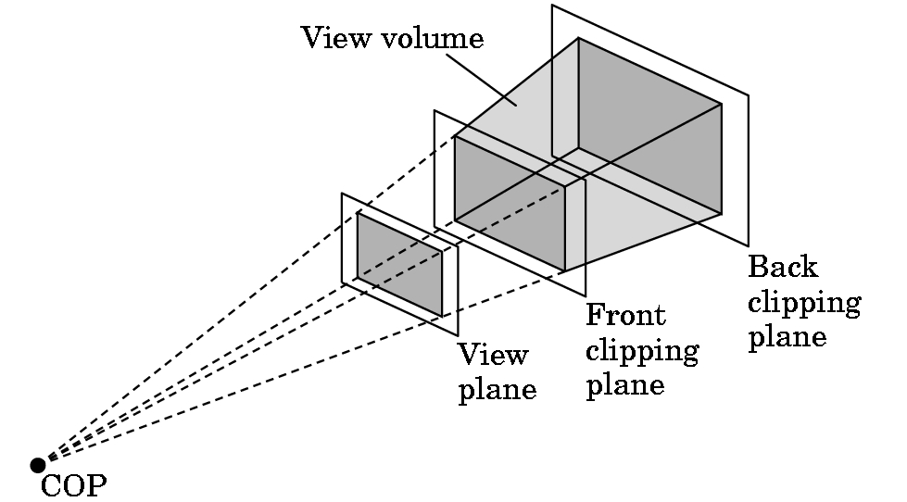
Clipping
Just as a real camera cannot “see” the whole world, the virtual camera can only see part of the world or object space
  Objects that are not within this volume are said to be clipped out of the scene
Word of the day: frustum!
Angel and Shreiner: Interactive Computer Graphics 7E © Addison-Wesley 2015, mods M. Evett

Slide 12
Rasterization
If an object is not clipped out, the appropriate pixels in the frame buffer must be assigned colors
Rasterizer produces a set of fragments for each object
Fragments are “potential pixels”
  Have a location in frame bufffer
  Color and depth attributes
Vertex attributes (e.g. color) are interpolated over objects by the rasterizer
Angel and Shreiner: Interactive Computer Graphics 7E © Addison-Wesley 2015, mods M. Evett

Slide 13
Fragment Processing
Fragments are processed to determine the color of the corresponding pixel in the frame buffer
Colors can be determined by texture mapping or interpolation of vertex colors
Fragments may be obscured by other fragments “closer” to the camera
  Hidden-surface removal
Angel and Shreiner: Interactive Computer Graphics 7E © Addison-Wesley 2015, mods M. Evett

Slide 14
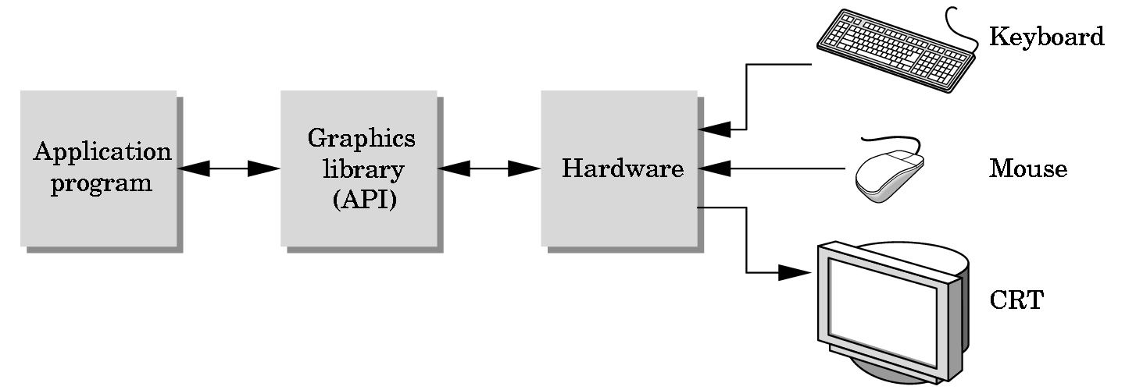
The Programmer’s Interface
Programmer sees the graphics system through a software interface: the Application Programmer Interface (API)
Angel and Shreiner: Interactive Computer Graphics 7E © Addison-Wesley 2015, mods M. Evett

Slide 15
API Contents
Functions that specify what we need to form an image
  Objects
  Viewer
  Light Source(s)
  Materials
Other information
  Input from devices such as mouse and keyboard
  Capabilities of system
Angel and Shreiner: Interactive Computer Graphics 7E © Addison-Wesley 2015, mods M. Evett

Slide 16
Object Specification
Most APIs support a limited set of primitives including
  Points (0D object)
  Line segments (1D objects)
  Polygons (2D objects)
  Some curves and surfaces
    Quadrics
    Parametric polynomials
All are defined through locations in space or vertices
Angel and Shreiner: Interactive Computer Graphics 7E © Addison-Wesley 2015, mods M. Evett

Slide 17
Example (old style)
type of object
location of vertex
glBegin(GL_POLYGON)
glVertex3f(0.0, 0.0, 0.0);
glVertex3f(0.0, 1.0, 0.0);
glVertex3f(0.0, 0.0, 1.0);
glEnd( );
end of object definition
Angel and Shreiner: Interactive Computer Graphics 7E © Addison-Wesley 2015, mods M. Evett
Notes:
OpenGL pre 3.1

Slide 18
Example (GPU based)
Put geometric data in an array
Send array to GPU
Tell GPU to render as triangle
vec3 points[3];
points[0] = vec3(0.0, 0.0, 0.0);
points[1] = vec3(0.0, 1.0, 0.0);
points[2] = vec3(0.0, 0.0, 1.0);
Angel and Shreiner: Interactive Computer Graphics 7E © Addison-Wesley 2015, mods M. Evett

Slide 19
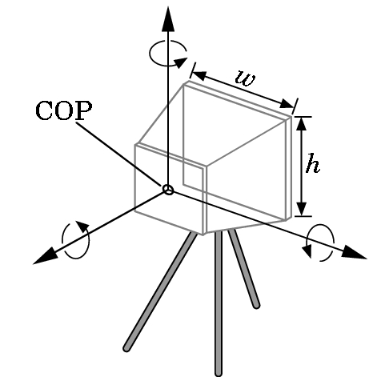
Camera Specification
Six degrees of freedom
  Position of center of lens
  Orientation
Lens
Film size
Orientation of film plane
Angel and Shreiner: Interactive Computer Graphics 7E © Addison-Wesley 2015, mods M. Evett

Slide 20
Lights and Materials
Types of lights
  Point sources vs distributed sources
  Spot lights
  Near and far sources
  Color properties
Material properties
  Absorption: color properties
  Scattering
    Diffuse
    Specular
Angel and Shreiner: Interactive Computer Graphics 7E © Addison-Wesley 2015, mods M. Evett

